Slide 1
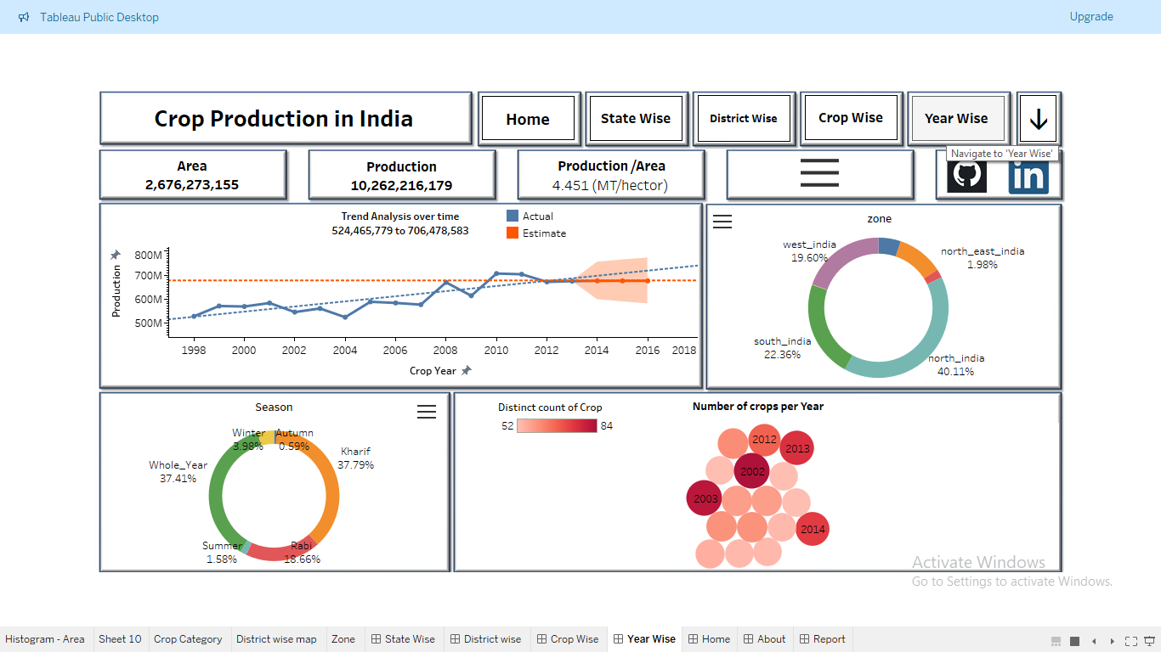
Crop Production Analysis in India
Presented by: Akash Shital Patil
UM ID : UMIP5670

Slide 2
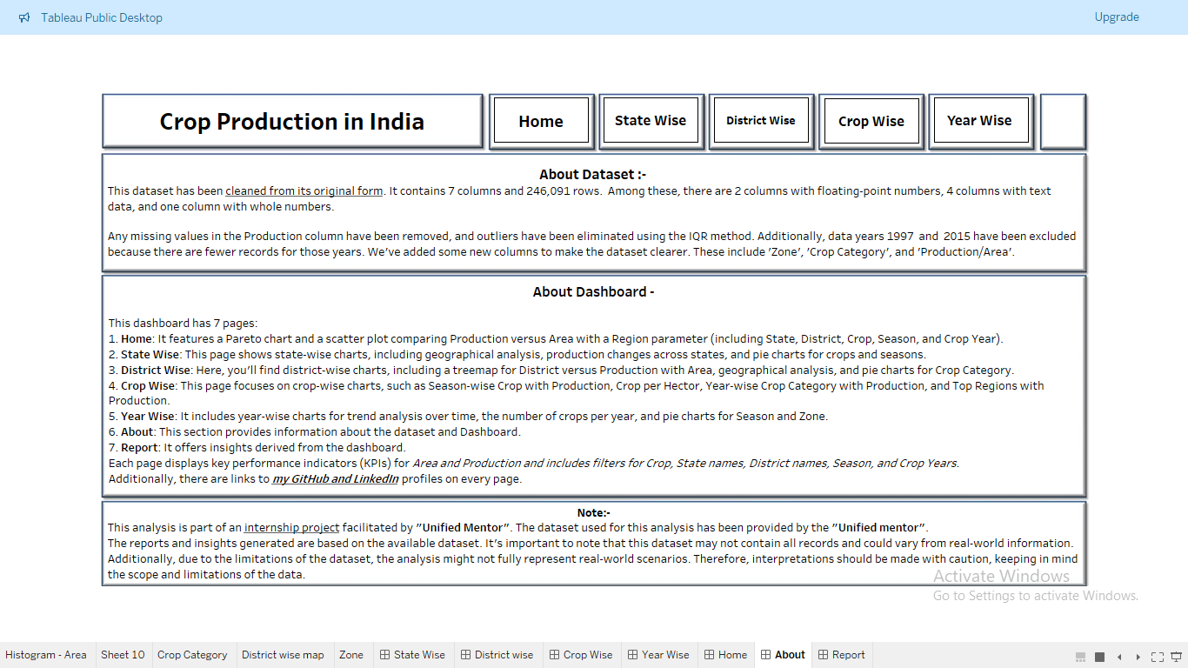
Introduction
Objective: Analyze agricultural data to understand production trends, crop distribution, and seasonal variations in India.
- Importance: Inform policymaking, resource allocation, and market strategies.
Note: Coconut crop data excluded as it represents count of nuts, not weight.

Slide 3
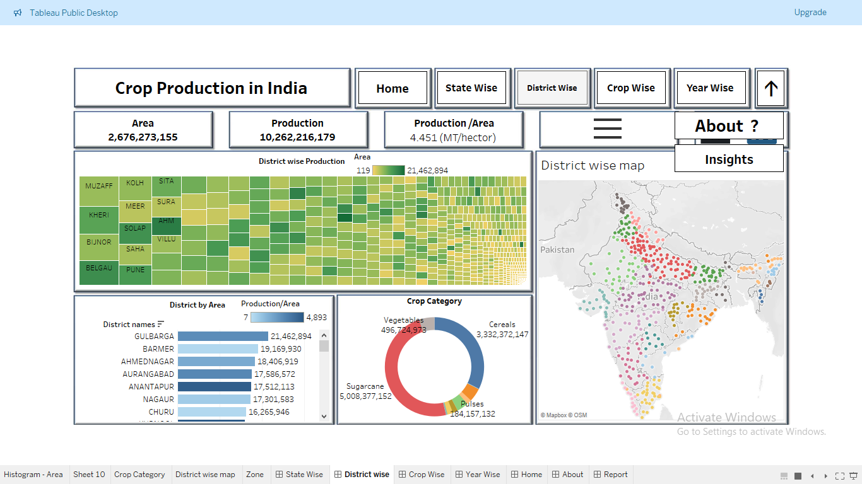
Insights Summary
1. Production Distribution
- Top states: Uttar Pradesh, Maharashtra, Tamil Nadu.
- Sugarcane dominates production (48.80%), followed by rice and wheat.
2. Seasonal Analysis
- Kharif season accounts for 37.79% of production.
- Rubi season contributes 18.66%.
- Winter and summer seasons contribute 3.98% and 1.58% respectively.
3. State-specific Insights
- Uttar Pradesh: Major crops include sugarcane, wheat, rice, and potato.
- Maharashtra: Dominated by sugarcane (75%), cotton lint, soybean, and rice.
4. Crop-wise Analysis
- Major crops during kharif season: Sugarcane, rice, cotton lint, maize, jute.
- Throughout the year: Sugarcane, potato, banana.

Slide 4
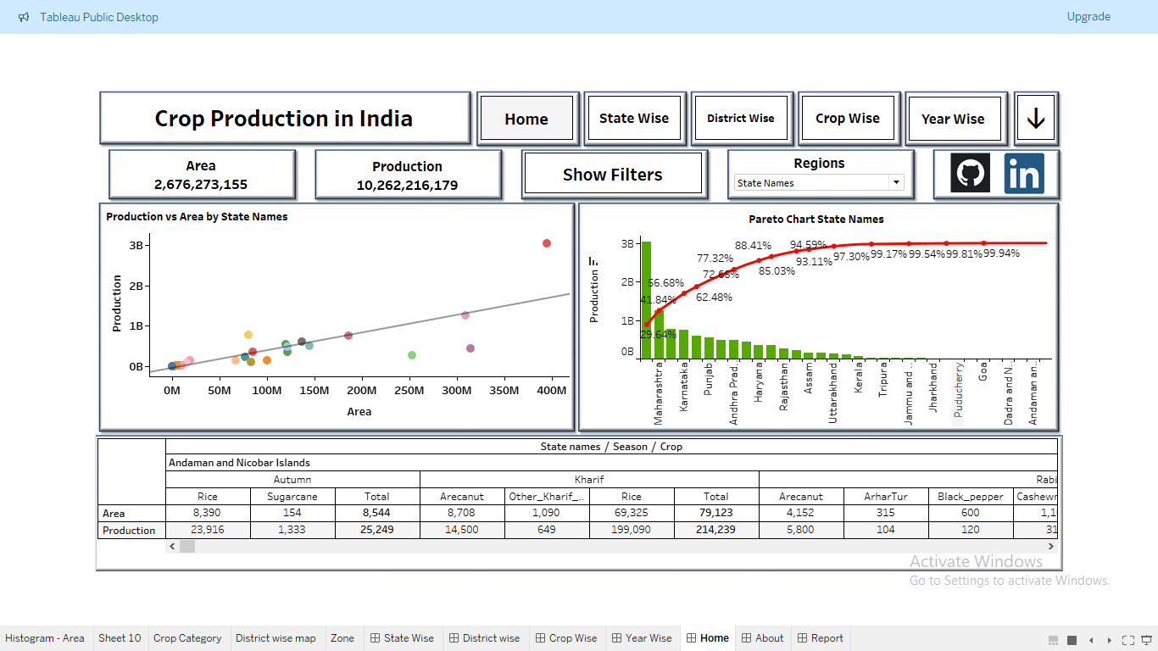
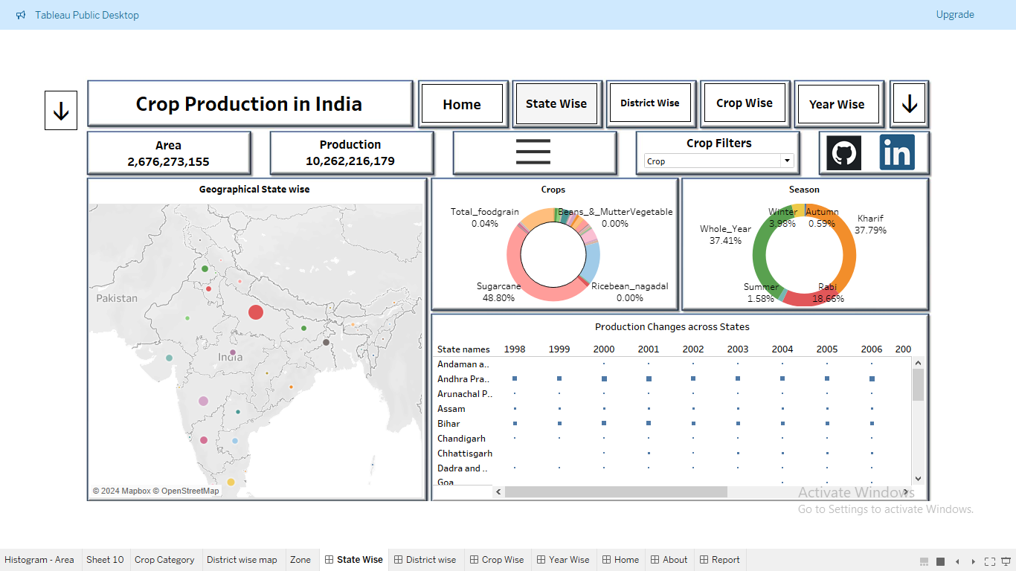
5. Crop Yield and Yearly Trends
- Highest yield per hectare: Sugarcane, papaya, banana, cabbage, grapes, tapioca.
- Top years for sugarcane: 2013, 2011, 2008.
6. Dataset Completeness
- Availability varies across years, highest in 2002 (84 crops).
7. Regional Production
- Kharif season: 45% of total production, North India contributes 41%.

Slide 5
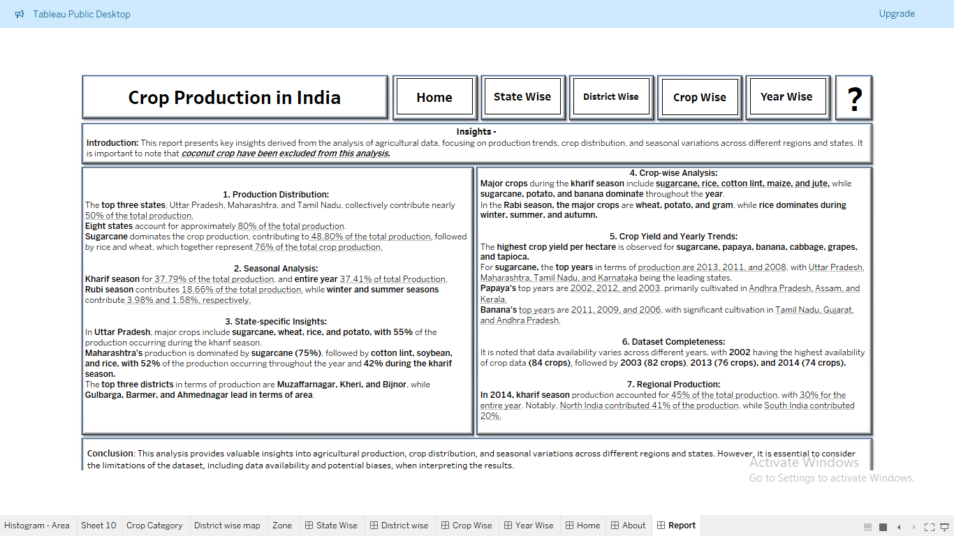
Conclusion
Agricultural sector dynamics influenced by seasonal variations, crop types, and regions.
Understanding production trends crucial for informed decision-making.

Slide 6
Documentation
Data Cleaning: Removed unnecessary columns, handled missing values.
EDA: Analyzed production trends, crop distribution, and seasonal variations.
Modeling: Chose regression model, split data, trained and evaluated model.
Conclusion and Documentation: Summarized findings, drew conclusions, documented workflow.

Slide 7
Thank You!
For any queries or further information, please contact:
Akash Patil
aakashgolu1008@gmail.com

